Slide 1



Corporate Takaful Products
Developers Incorporate

Slide 2

Outline
Group Health Care Takaful Scheme
Benefits Covered
Hospitalization
Day Care Treatment
Short Stay ER Treatment
Specialized Tests
How to claim ?
Advantages & Disadvantages ?
Question n Answers Session

Slide 3

Group Healthcare Takaful Scheme

Slide 4

Details
&
Benefit Criteria

Slide 5

Hospital Care Benefit:
Covers expenses incurred during hospital stay up to the “Per Annum Limit” including the charges for :
Room, Operation theatre and ICU
Physician, Surgeon and Anaesthetist fee
Diagnostic tests including MRI and CT Scan
Medicines required during hospital stay
Kidney Dialysis and Cancer treatment
Organ transplant
Endoscopy and Angioplasty
Oxygen and blood supplies
Pre-hospitalization Expenses related to Admission-Comprehensive (Up to 30 days)
Post-hospitalization Follow-ups-Comprehensive (Up to 30 days)

Slide 6

Benefits Conti---
Day Care Surgical Procedures—Terms and Conditions are Applicable
Following Day Care Surgeries
Cataract Surgery
Treatment of Fractures and Lacerated wound
Piles surgery
Septoplasty
Circumcision
Fissure and Fistula Surgery
Sebaceous cyst excision
Dilation and Curettage
Partial Mastectomy
Varicose (cutting operation only)
Non Malignant Tumors/ Abscess
Cholecystectomy
Note: These are few listed procedures (for illustration purpose) out of numerous treatments that Pak Qatar Family Takaful covers under Health Takaful Coverage

Slide 7
Benefits Conti---
Day Care Non Surgical Procedures
These are specially covered in this scheme
Chemotherapy
Radiation Therapy
Dialysis
Lithotripsy
Note: These are few listed procedures (for illustration purpose) out of numerous treatments that Pak Qatar Family Takaful covers under Health Takaful Coverage

Slide 8
Benefits Conti--
Specialized Tests—Terms and Conditions are Applicable
Following are the examples
MRI—Shoulder-Neck, Head and Brain
CT Scan Shoulder-Neck, Head and Brain
Endoscopy-It means to visualize inside of a cavity
Different Types of Endoscopy
Gastroscopy---Inspection of our Stomach
Bronchoscopy-Inspection of our Lungs Cavity
Cystoscopy—Inspection of Urinary Bladder
Colonoscopy—Inspection of Intestines
Duodenoscopy-Inspection of Duodenum
Esophagostomy-Inspection of Esophagus
Hysteroscopy-Other than Infertility
Note: These are few listed procedures (for illustration purpose) out of numerous treatments that Pak Qatar Family Takaful covers under Health Takaful Coverage

Slide 9
Benefits Conti--
Short Stay Emergency Treatment.
Medical Emergency
Severe Chest Pain
High Grade Fever
Heat Stroke
Repeated vomiting leading to Dehydration
Renal Pain
Accidental Emergency
History of falls from Stairs
Road Traffic Accident
Ingestion of Foreign Body etc.
Note: Mode of provision is mainly via Credit, but if cash is paid due to Hospital Policy, then same can be reimbursed from Pak-Qatar.

Slide 10
Unique Benefits
24 Hour Help Line to provide counseling & welfare to patients and a Dedicated Relationship Manager to cater all the needs.
Specialized Tests including MRI, CT Scan, Endoscopy, Biopsy, Thallium Scan & Angiographies covered even as Out-Patient
if no hospitalization takes place (with prior approval)
More than 300+ network hospitals for easy access country wide and more are being added to the Network
Coverage of Accidental and Non–Accidental Emergency treatment
Non-Panel Expenses should be reasonable and customary.
Comprehensive cover available for Pre & Post Hospitalization.

Slide 11
Entitlement
Benefit | Plan A | In case of Accidental Cases
Hospital Care Benefit | 250,000 | 500,000
Room and Board | 12,000
Pre-Hospitalization Charges up to 30 Days- Comprehensive | Covered
Post-Hospitalization Charges up to 30 Days-Comprehensive | Covered
Normal Delivery | 100,000
C-Section | 150,000

Slide 12
Terms and Conditions
Pre-existing Conditions are covered up to 100%
Congenital (By Birth Defects) Illness are covered up to 100%
Hepatitis B & C Treatment Cost are covered up to 100%
Pre Existing Maternities are Covered.
Additional Charges for visiting doctor are not payable.

Slide 13

Group HealthCare Takaful

Slide 14

How to claim
Planned & Emergency
@ Network Hospital
@ Non-Network Hospital

Slide 15
Procedure for Hospital Admission
Non-Emergency Case:
After getting consultation, if you are advised a surgical procedure by a Panel Consultant or you are advised CT/MRI etc. then following can be the further approaches
you can present Prescription to Corporate office of Panel Hospital along with health card copy and CNIC Copy. They will assist you to complete our Pre-authorization form and duration of history is very important to disclose.
2. You can yourself complete our Pre-authorization form and share it with PQFT on approvals@pakqatar.com.pk along with Prescription. Duration of disease is mandatory.
Same can be routed via our Mobile Apps-Elaaj.
Same can be routed via your HR.
Same can be routed via our Corporate Sales Manager.
Mandatory Documents.
1.Doctor Prescription.
2. Pre-authorization form.
3.Health Card Copy.
4.CNIC Copy at the time of admission.

Slide 16
Procedure for Hospital Admission
Emergency case:
Pre-Authorization is not recommended in an “Emergency Medical Condition”
Proceed to the nearest hospital and go to the emergency department.
You may contact our 24/7 Emergency numbers for any support.
It is advisable, if possible, to visit a Network hospital as they are all located in major localities of the city. (A hospital that is not on our Network will require Cash payment before admitting the patient. In addition, you cannot be sure of the quality of care available).
Within 24 hours of hospital admission, It is mandatory to inform Pak-Qatar Family Takaful via Numbers mentioned on health card.
Company’s Name and Employee ID Number
Name of the treating hospital
The reason of admission (Diagnosis)

Slide 17
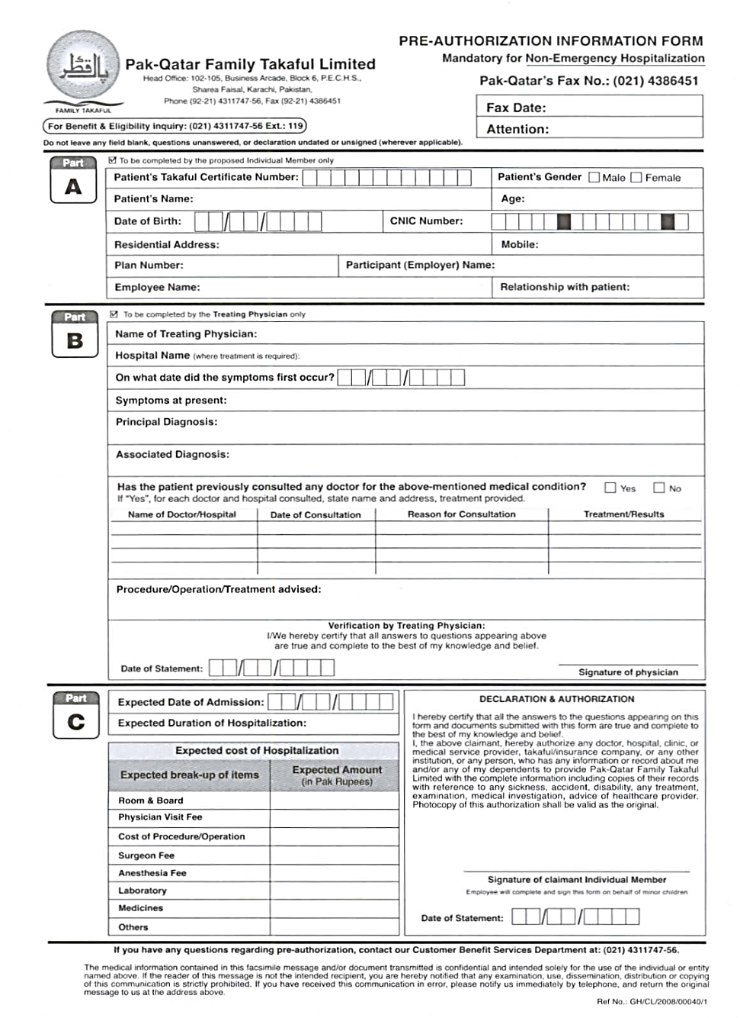
Pre-Authorization Form

Slide 18
Disadvantages of Using a non-Network Hospital
You have to Pay cash and then seek reimbursement
You are responsible for collecting all required documentation.
You are responsible for completing the claim form and getting it signed by the treating physicians/surgeons.
You have to wait for 15 working days after submitting complete documentation to receive the reimbursement cheque.
You cannot be sure if the Hospital is adequately equipped or that the Doctor is qualified to perform the procedure.
You have to call us within 24 hours of hospital admission
Reimbursement is inline with the Panel Hospital rates.

Slide 19
Documents Required for Claims Reimbursement (in-Patient)
In Case Of Non-Network Hospitals:
Duly filled Claim Form A n B.
Clinical Summary / Discharge Card
Itemized Hospital Bill-Original
All prescriptions for medicines used during hospitalisation
Receipts of Medicines received-Original
Laboratory Reports with payment receipts-Original
All other payment receipts-Original
Provisional Birth Certificate (issued by the Hospital) in case of child birth

Slide 20
Claim Form – Part A
Claim Form – Part B

Slide 21
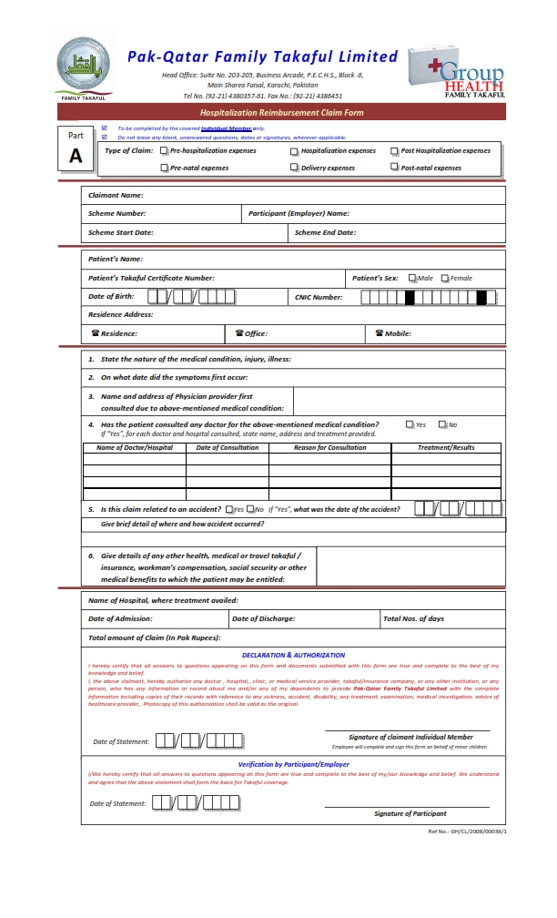
Claim Form – Part A

Slide 22
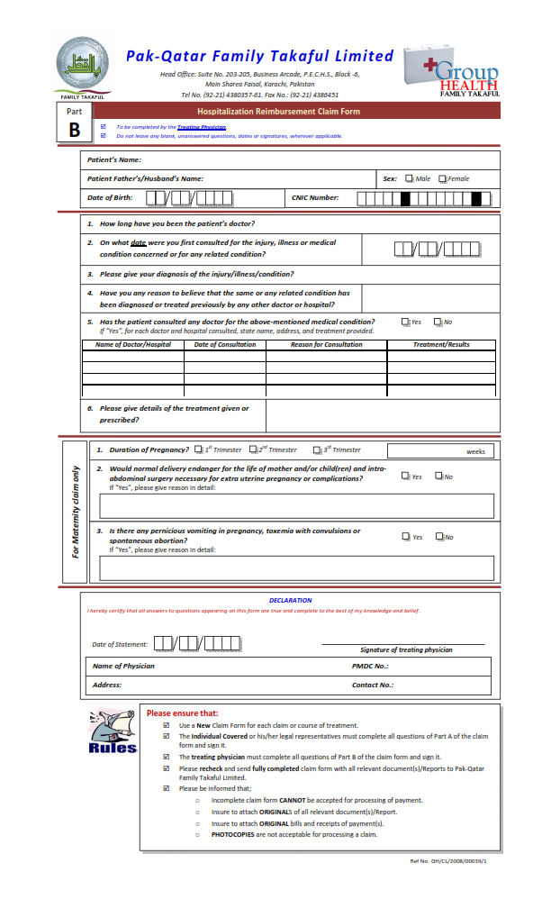
Claim Form – Part B

Slide 23
Advantages of Using a Network Hospital
Credit facility. No drain on your personal cash flows
No need to collect documents and file claims. We reimburse network hospitals directly
Treatment at hospitals with Good functional facilities
Treatment by Credentialed physicians and surgeons qualified and trained to discharge the specific treatment.
In Emergencies, you do not have to call us; this is the responsibility of the Panel Hospital

Slide 24

Exclusions
Routine Medical Examinations – OPD
Treatment Related to Infertility, Contraception, Sterilizations
Prosthesis, Corrective Devices and medical appliances which are not surgically required
All cost related to transplant from a donor to recipient
Treatment of Mental Illness, Psychiatric or Nervous disorders
Self Inflicted Injuries, Suicide, Abuse of Alcohol, drug addiction
STD, AIDS or AIDS related conditions or diseases.
Elective Overseas treatment & Cosmetic Treatment
Experimental or unproved treatment & Dental Treatment
Injury or illness while serving as a full-time member of police or military unit.
Treatment resulting from participation in war, riot, civil commotion or any illegal act which may result in imprisonment.
Costs arising out of any litigation or dispute between individual covered and any medical person or establishment from whom treatment has been sought.

Slide 25

Important Telephone Numbers
24 Hours Medical Hotline: 0301 8223385
Customer Service: 021-111-Takaful (825238)
DURING OFFICE HOURS: (021) 34311747 - 56

Slide 26

Our
Panel Hospital Network

Slide 27
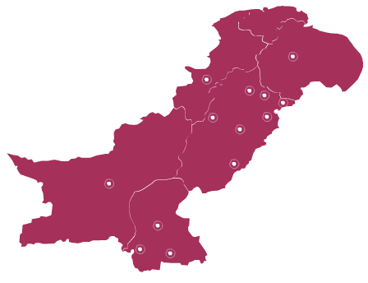

Hospital Network Across Pakistan-273
Mirpur (AJK) = 1
Peshawar =3
Mardan = 1
Islamabad = 5
Rawalpindi = 7
Sargodha = 1
Abbottabad = 1
Quetta = 2
Lahore = 20
Sheikupura = 1
Sialkot = 2
Faisalabad = 5
Gujranwala = 3
Rahim Yar Khan = 1
Multan = 4
Karachi city = 44 Hyderabad = 2
Sukkur = 2

Slide 28
جزاکم اللہ تعالیٰ خیرا

